Slide 1
Machine Learning as a Service

Slide 2
Probable Technologies Involved
Problem Statement –
Probable Technologies Involved
Design a web UI based end to end scalable solution to showcase and host all possible use cases, offerings and services from Synoptek Data Science / BI vertical
SQL data base to store historical data.
Local Storage location / Azure blob storage / AWS S3 bucket
Data analytics workspace / Azure VMs / AWS ec2
Machine Learning workspace / Azure ML / AWS Sagemaker
Web UI / Azure or AWS endpoints
Power BI / QuickSight
Objectives
Create a repository to host all solutions and to collaborate as a team.
Create Web UI as an user interface.
Educate the internal stakeholders about the offerings from Synoptek Data Science / BI vertical.
Demonstrate capabilities and services offered to our end customers.
Tools / Technologies Used
Postgress SQL database
Visual code studio
Python
Sklearn / Tensorflow
Streamlit

Slide 3




Stakeholders involved
Customer Support Teams
Marketing Department
End Customers
Sales Department
Product Management Teams

Slide 4
Process Flow
Ideation
- Define Problem.
------------------------
- Analyse Market.
------------------------
- Brainstorm.
------------------------
- Choose the most innovative idea.
Data Collection
- Look for probable available data.
------------------------
- Prepare data as per the industry standards.
------------------------
- Generate synthetic data if required.
Development
- Host the collected to possible database.
------------------------
- Prepare scripts for data manipulation, feature engineering, feature selection.
------------------------
- Prepare scripts model training, evaluation.
------------------------
- Prepare a script for a Web UI.
------------------------
- Prepare analytical BI dashboard
Deployment
Serving/Onboarding of Stakeholders
- Upload the developed solution to a repository.
------------------------
- Connect the repository to deployment container.
------------------------
- Execute the container to generate the results.
------------------------
- Publish the generated results on Web UI.
------------------------
- Publish the prepared BI dashboard to the Web UI.
- Project Management Teams
---------------------
- Marketing Department
---------------------
- Sales Department
---------------------
- End Customers
---------------------
- Customer Support Teams

Slide 5










Solution Architecture
Input data from user
Data Analytics
Machine Learning
Data Labelling
Feature Engineering
Feature Selection
Historical Data
Storage Local
Webservice & BI dashboard

Slide 6
Probable steps – Web UI Architecture
Create a web UI using streamlit.
Page1: Batch Prediction Service
Page2: Analytical BI dashboard
Operations in Page1:
Load the saved model inside web UI
Accept the data from user as per the schema given in table 1 & 2 in page1
Click to generate prediction for the user data uploaded by user in web UI page1
Display the churn result and related plots and metrics in the web UI
Operations in Page2:
Display the analysis of the customer purchase habits and patterns using the BI dashboard hosted on the Web UI

Slide 7
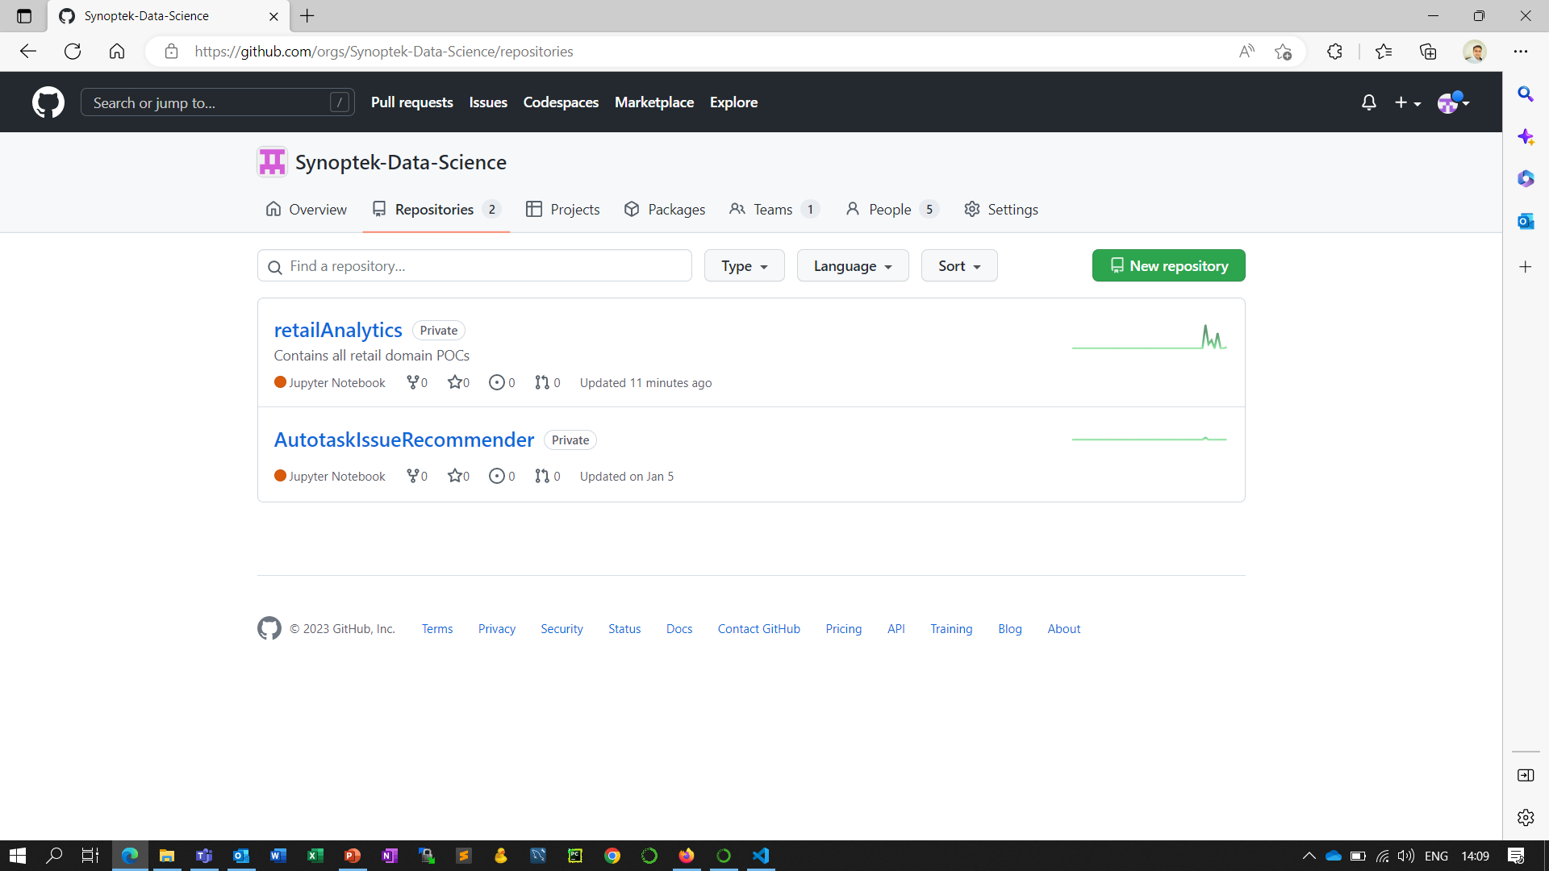
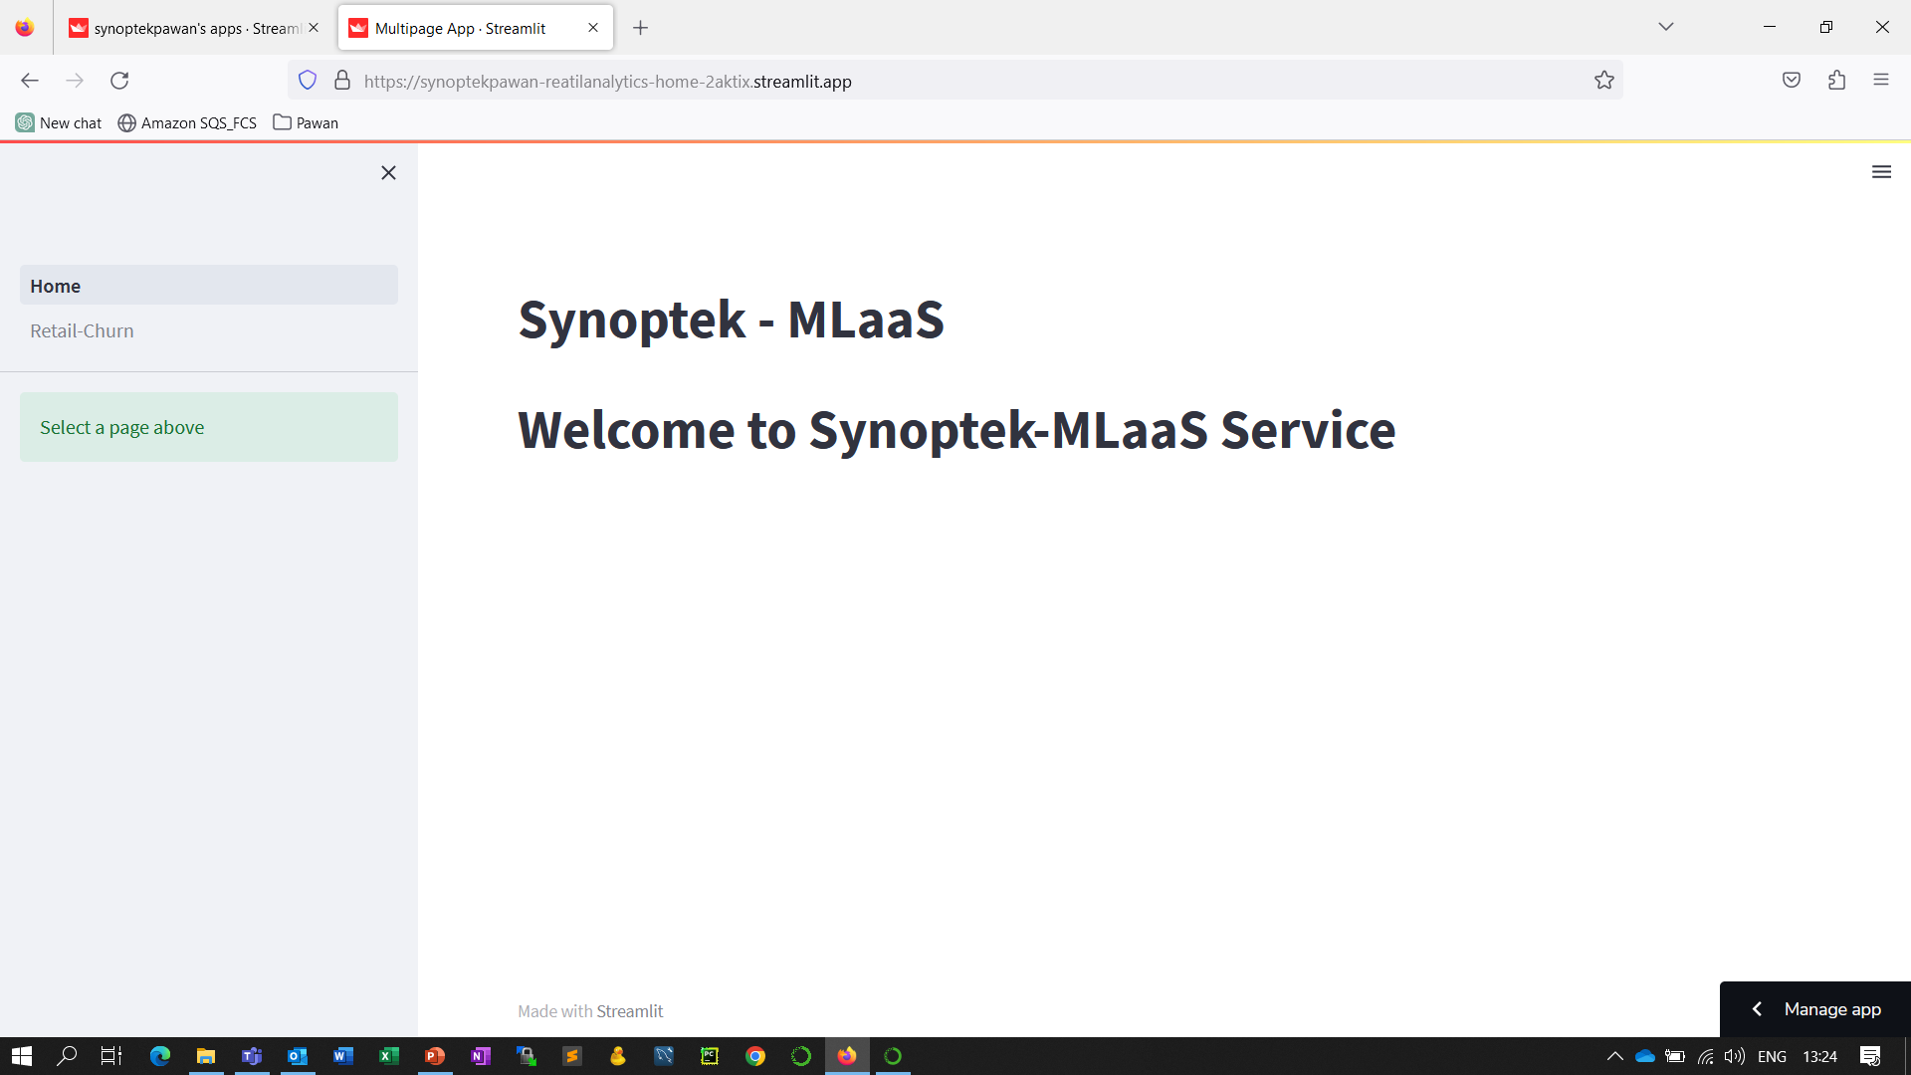
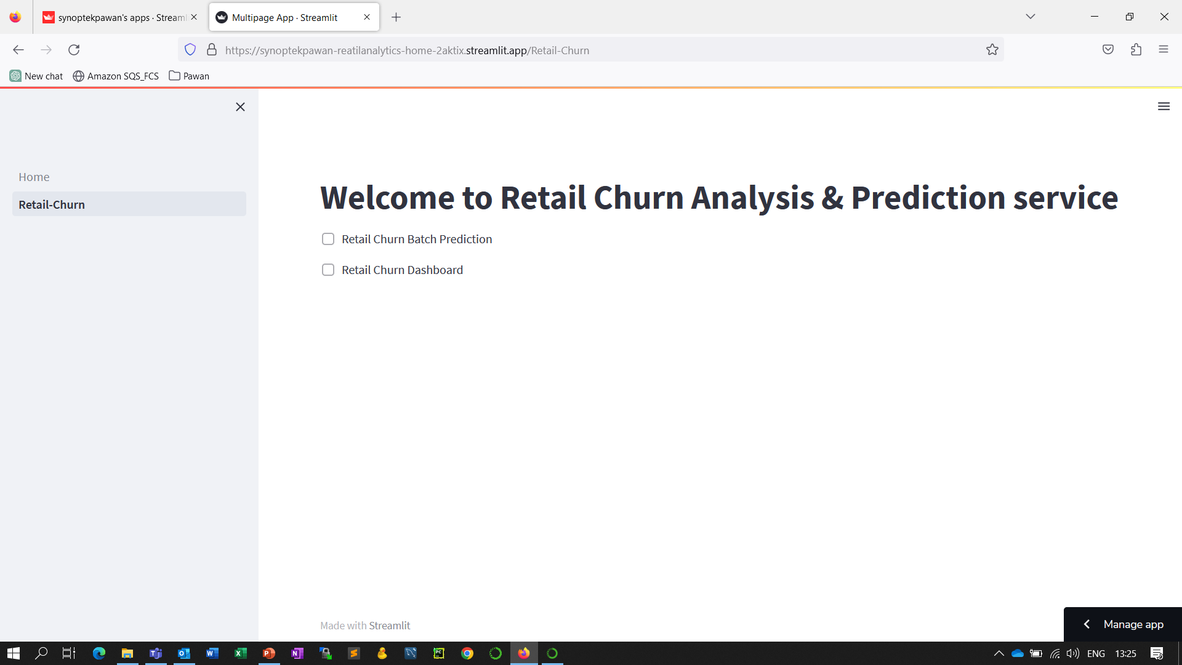
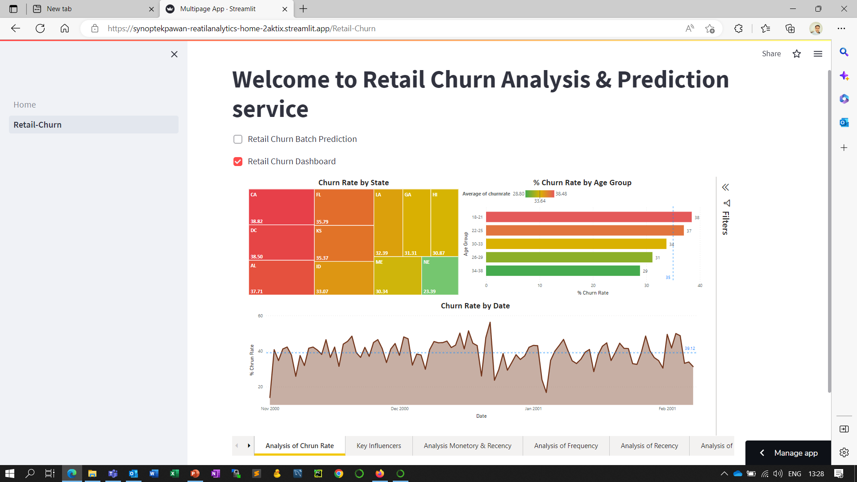
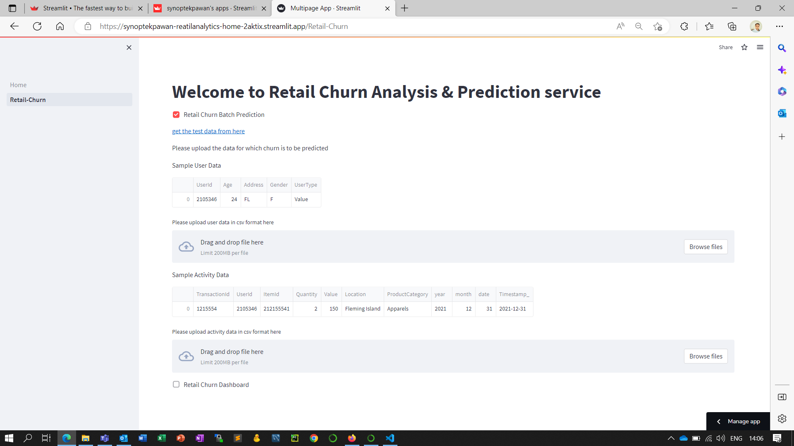
Some Snaps from Web UI
Synoptek-Data-Science (github.com)
MLaaS Web UI/ App · Streamlit

